Slide 1
Array – Part2
Rakib Mahmud

Slide 2
Introduction to 2D Array
A 2D array is also known as a matrix (a table of rows and columns).
The first dimension represents the number of rows, while the second dimension represents the number of columns.
The values are placed in row-order.

Slide 3
2D Array Declaration
Data_type array_name [row_size] [col_size]
Example:
Int Matrix[2][3];
Number of variables= rows*columns
 | Column 0 | Column1 | Column 2
Row 0 | Matrix[0][0] | Matrix[0][1] | Matrix[0][2]
Row 1 | Matrix[1][0] | Matrix[1][1] | Matrix[1][2]

Slide 4
2D Array Initialization
Initiazing 1st row
Matrix[0][0] = 1
Matrix[0][1] = 2
Matrix[0][2] = 3
Initiazing 2nd row
Matrix[1][0] = 4
Matrix[1][1] = 5
Matrix[1][2] = 6
This work can be done directly
Int Matrix[2][3] = { {1, 2, 3}, {4, 5, 6} };
 | Column 0 | Column1 | Column 2
Row 0 | Matrix[0][0] | Matrix[0][1] | Matrix[0][2]
Row 1 | Matrix[1][0] | Matrix[1][1] | Matrix[1][2]
 | Column 0 | Column1 | Column 2
Row 0 | 1 | 2 | 3
Row 1 | 4 | 5 | 6

Slide 5
2D Array Display
printf(“%d ”,Matrix[0][0]);
printf(“%d ”,Matrix[0][1]);
printf(“%d ”,Matrix[0][2]);
printf(“\n”);
printf(“%d ”,Matrix[1][0]);
printf(“%d ”,Matrix[1][1]);
printf(“%d ”,Matrix[1][2]);
 | Column 0 | Column1 | Column 2
Row 0 | 1 | 2 | 3
Row 1 | 4 | 5 | 6
for(int i=0;i<no_row;i++)
{
for(int j=0;j<no_col;j++)
{
printf(“%d “,Matrix[i][j]);
}
printf(“\n”);
}
A nested loop can be used here

Slide 6
2D Array (Getting User Input)
scanf(“%d ”,&Matrix[0][0]);
scanf(“%d ”,&Matrix[0][1]);
scanf(“%d ”,&Matrix[0][2]);
scanf(“\n”);
scanf(“%d ”,&Matrix[1][0]);
scanf(“%d ”,&Matrix[1][1]);
scanf(“%d ”,&Matrix[1][2]);
 | Column 0 | Column1 | Column 2
Row 0
Row 1
for(int i=0;i<no_row;i++)
{
for(int j=0;j<no_col;j++)
{
scanf(“%d “,&Matrix[i][j]);
}
}
A nested loop can be used here

Slide 7
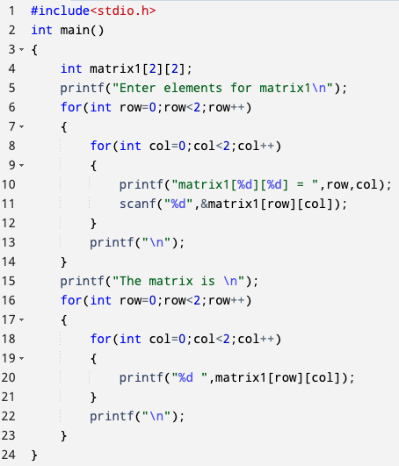
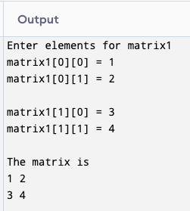
C Program to Create a Simple Matrix and Display It

Slide 8
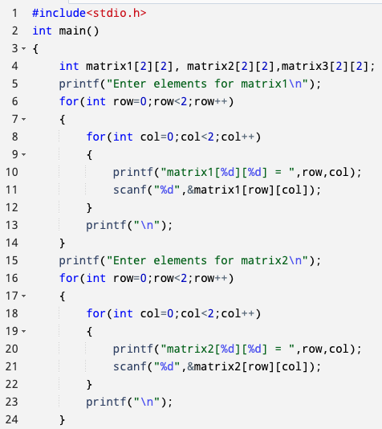
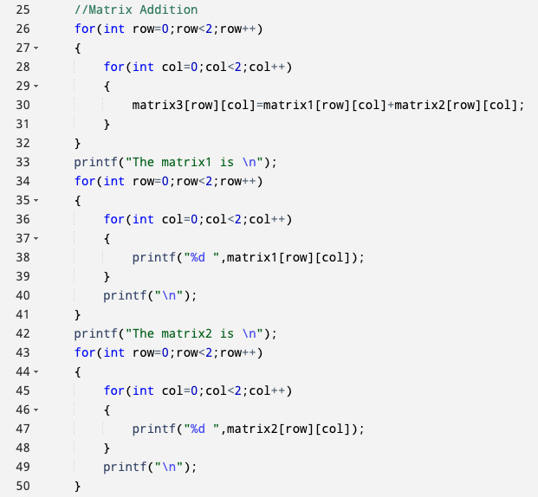
C Program to Do Matrix Addition

Slide 9
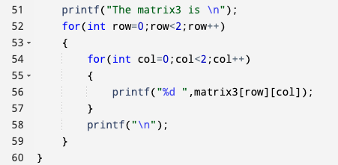
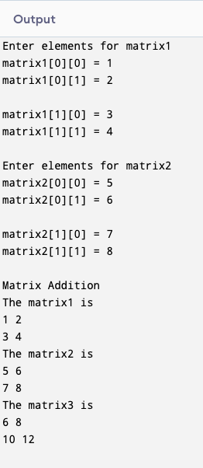
C Program to Do Matrix Addition (Cont’d)

Slide 10
Matrix Multiplication
Matrix 1
Matrix 2
 | Column 0 | Column 1
Row 0 | 1 | 2
Row 1 | 3 | 4
Row 2 | 5 | 6
 | Column 0 | Column 1 | Column 2
Row 0 | 1 | 2 | 3
Row 1 | 4 | 5 | 6
For matix multiplication column of the first matrix must be equal
to the row of second.
Otherwise matix multiplication is not possible.

Slide 11
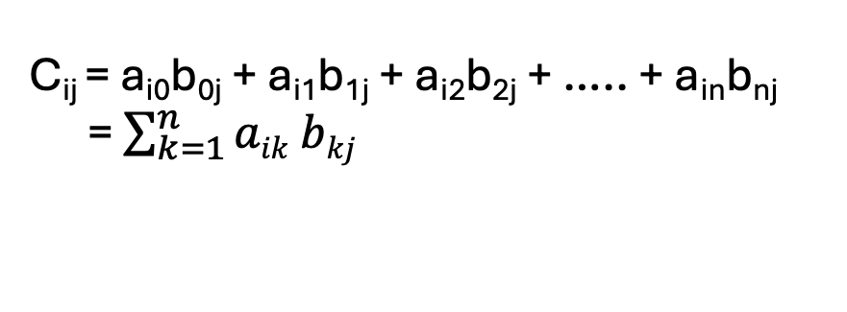
Matrix Multiplication (Cont’d)
Matrix 1
Matrix 2
 | Column 0 | Column 1
Row 0 | 1 | 2
Row 1 | 3 | 4
Row 2 | 5 | 6
 | Column 0 | Column 1 | Column 2
Row 0 | 1 | 2 | 3
Row 1 | 4 | 5 | 6
New dimension of the matix will be = 1st matrix row_no * 2nd matrix column_no
Matrix3
 | Column 0 | Column 1 | Column 2
Row 0 | 9 | 12 | 15
Row 1 | 19 | 26 | 33
Row 2 | 29 | 40 | 51
C_{ij} = a_{i0}b_{0j} + a_{i1}b_{1j} + a_{i2}b_{2j} + ….. + a_{in}b_{nj}
= $\sum_{k=1}^{n}{aik bkj}$

Slide 12
Matrix Multiplication (Cont’d)
sum = 0;
sum = matrix1[0][0] * matrix2[0][0] + matrix1[0][1]*matrix2[1][0];
sum = sum + matrix1[i][k] * matrix2 [k] [j];
matrix3[i][j] = sum

Slide 13
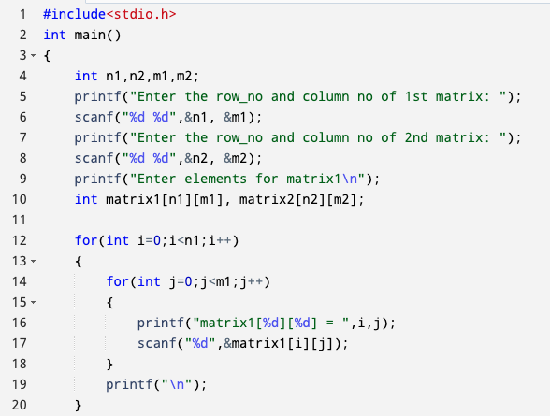
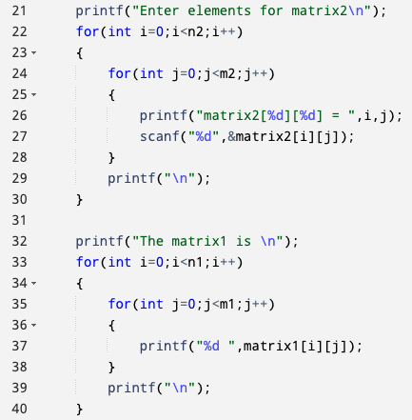
C Program to Do Matrix Multiplication

Slide 14
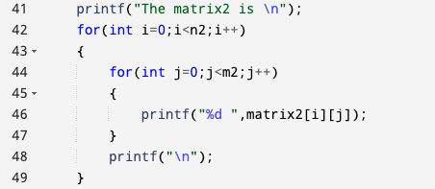
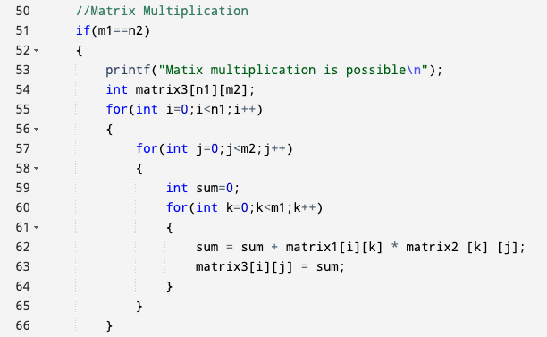
C Program to Do Matrix Multiplication(Cont’d)

Slide 15
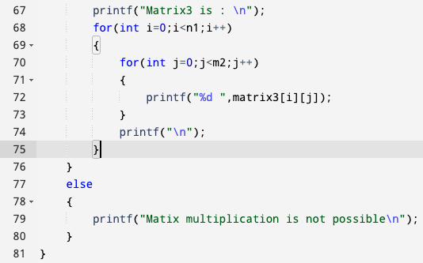
C Program to Do Matrix Multiplication(Cont’d)
You would find the entire code here:
https://smalldev.tools/share-bin/mCBCdvkO

Slide 16
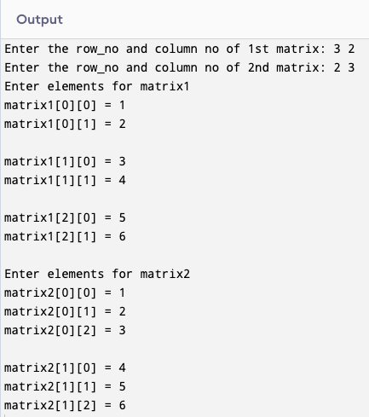
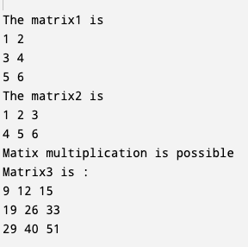
C Program to Do Matrix Multiplication(Cont’d)

Slide 17
Transpose Matrix
Matrix 1
Matrix 2
(Transpose Matrix)
 | Column 0 | Column 1
Row 0 | 1 | 2
Row 1 | 3 | 4
Row 2 | 5 | 6
 | Column 0 | Column 1 | Column 2
Row 0 | 1 | 3 | 5
Row 1 | 2 | 4 | 6
First matrix row = Second matrix column
Or, First matrix column = Second matrix row

Slide 18
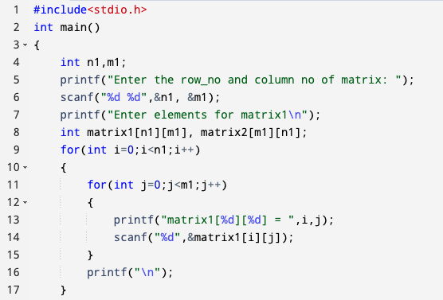
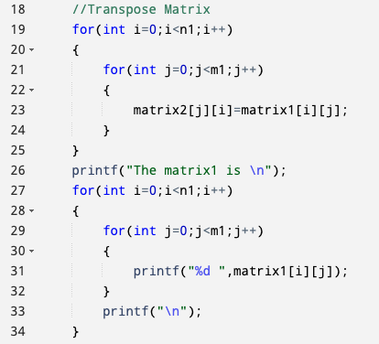
C Program to Do Transpose Operation of a Matrix

Slide 19
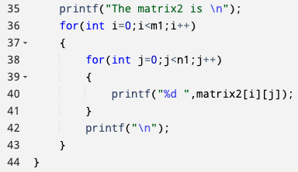
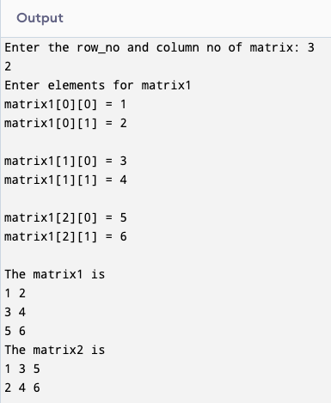
C Program to Do Transpose Operation of a Matrix

Slide 20
Sum of Diagonal, Upper & Lower Triangle Elements
 | Column 0 | Column 1 | Column 2
Row 0 | 9 | 12 | 15
Row 1 | 19 | 26 | 33
Row 2 | 29 | 40 | 51
When row index and column index are equal diagonal elements are found.
When row index is less than column index upper triangle elements are found.
When row index is greater than column index lower triangle elements are found.

Slide 21
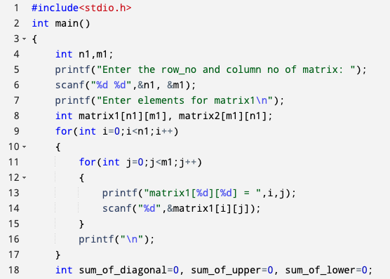
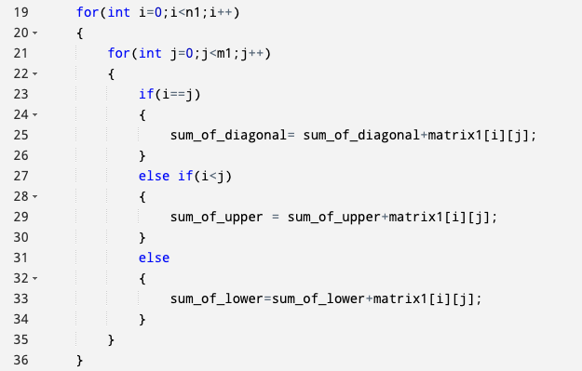
C Program to Do Sum of Diagonal, Upper & Lower Triangle Elements

Slide 22
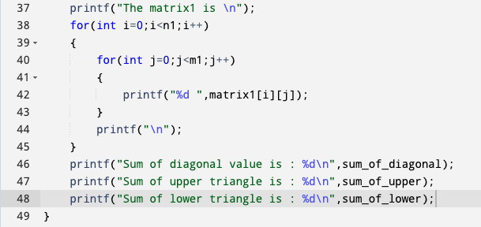
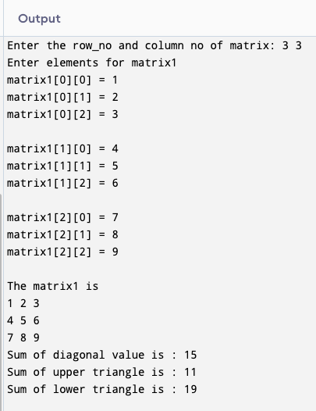
C Program to Do Sum of Diagonal, Upper & Lower Triangle Elements (Cont’d)

Slide 23
Exercises
Matrix Subtraction for 2D array,

Slide 24
Thank You

